Slide 1
Concise Implementation of Linear Regression
Eng Teong Cheah

Slide 2
Objective
The surge of deep learning has inspired the development of a variety of mature software frameworks, that automate much of the repetitive work of implementing deep learning models. In the previous section we relied only on NDarray for data storage and linear algebra and the auto-differentiation capabilities in the autograd package. In practice, because many of the more abstract operations, e.g. data iterators, loss functions, model architectures, and optimizers, are so common, deep learning libraries will give us library functions for these as well.

Slide 3
目录
Concise Implementation of Linear Regression

Slide 4

Concise Implementation of Linear Regression

Slide 5
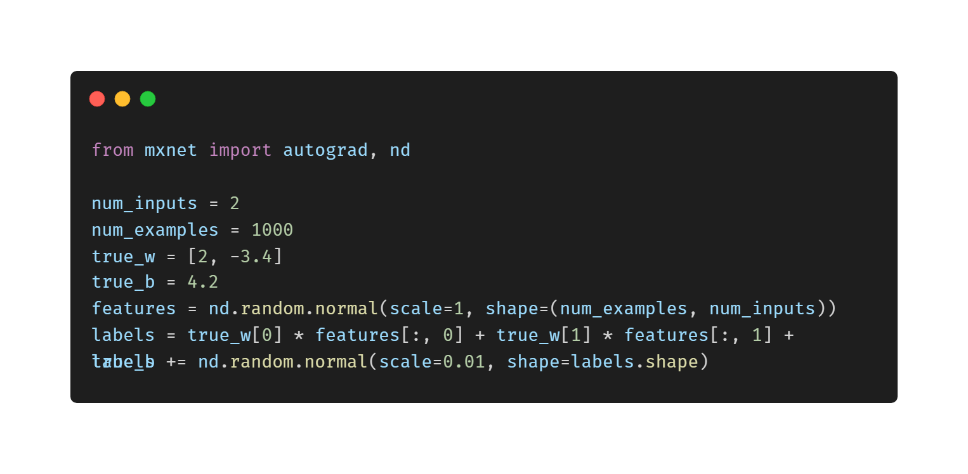
Generating Data Sets

Slide 6
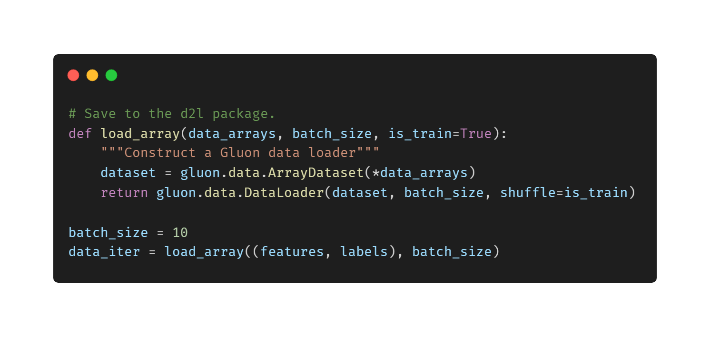
Reading Data

Slide 7
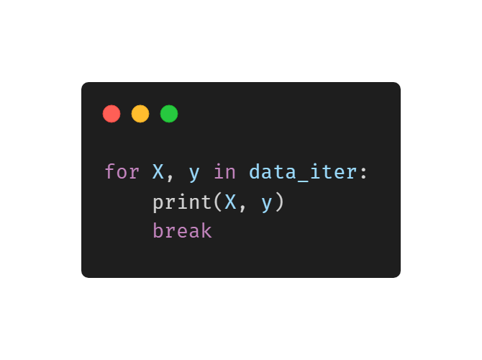
Reading Data
[-1.130275 0.3379702 ] [ 0.39320782 1.5395709 ] [-0.06822178 0.72335476] [-2.0644426 0.50765425] [ 0.03313668 1.3074721 ] [-0.52480155 0.3005414 ] [ 1.4612247 0.9584059 ] [ 0.4652423 -0.5965788 ]] <NDArray 10x2 @cpu(0)> [-2.7828512 12.15272 0.7970579 -0.25150746 1.5961332 -1.6511697 -0.18884937 2.1383817 3.8612688 7.1612334 ] <NDArray 10 @cpu(0)>

Slide 8
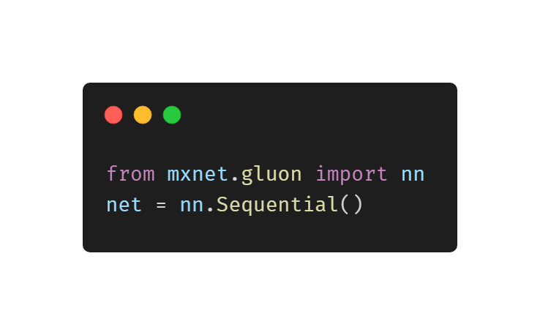
Define the Model

Slide 9
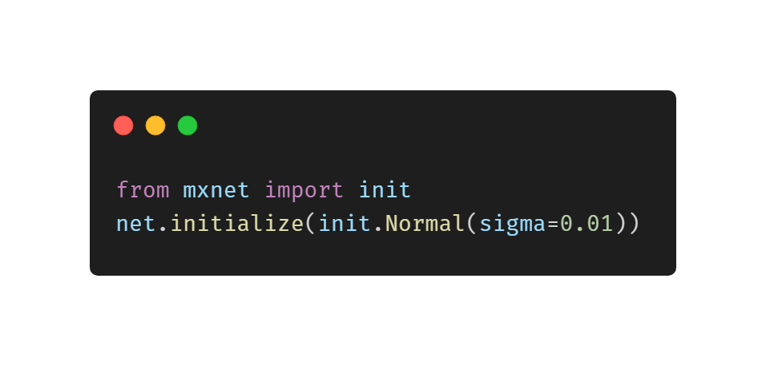
Initialize Model Parameters

Slide 10
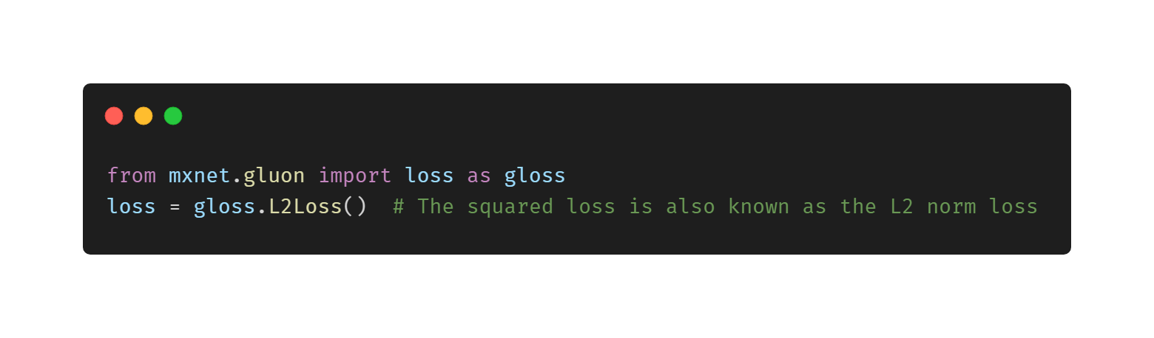
Define the Loss Function

Slide 11
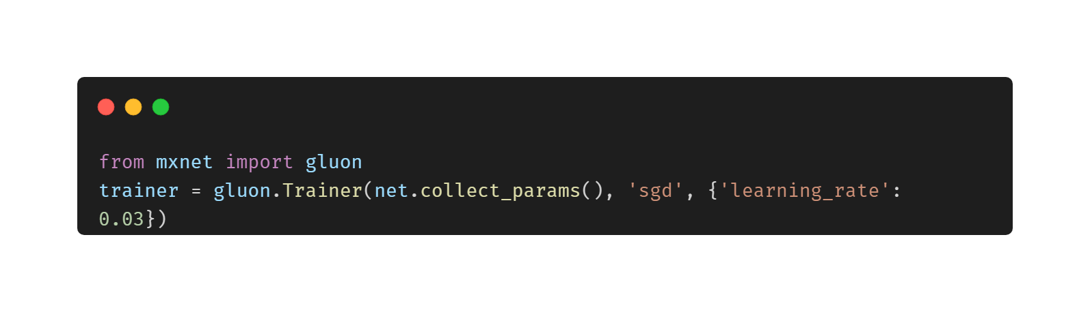
Define the Optimization Algorithm

Slide 12
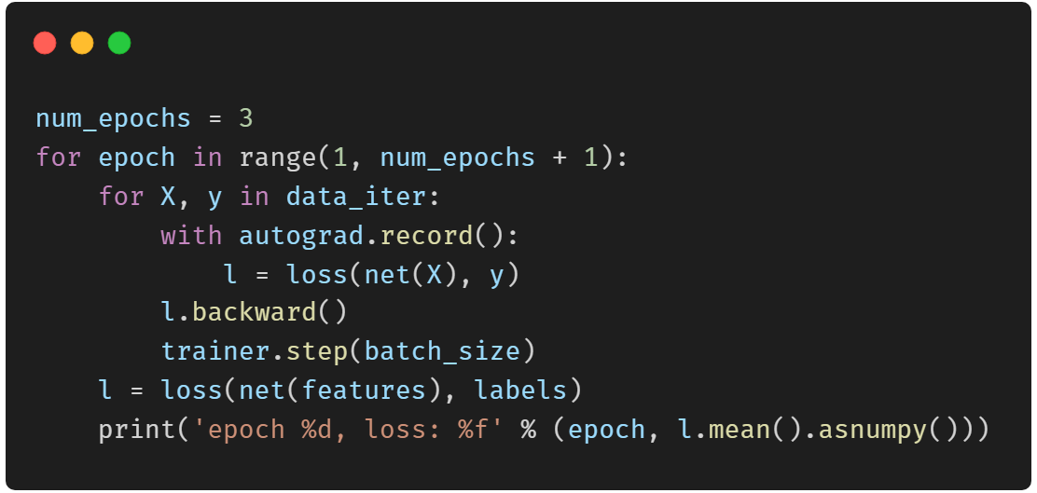
Training

Slide 13
Thank You!
Does anyone have any questions?
Twitter: @walkercet
Blog: https://ceteongvanness.wordpress.com

Slide 14
Resources
Dive into Deep Learning

